Slide 1

You’re Doing Agile Right, but agile wrong
Slides at scottsauber.com
scottsauber
Notes:
Open AgileManifesto.org and the 12 principles
Open dora.dev and the Quick Check

Slide 2

Audience
Looking to get more out of your Agile processes
People feeling like they’re doing the Agile things without the agile outcomes
scottsauber

Slide 3
Poll
How many people doing Scrum?
SAFe?
Kanban?
Scrumban?
Their own thing?
Waterfall?

Slide 4
Agenda
Polls – who’s using, what are you using, w
What are still relevant?
SaaS is dead
Jevon’s Paradox
Tools worse they will ever be
Models
Prompts
Tools
Context
Instructions, Skills
Copilot Modes
Copilot Coding Agent
Ask Copilot Coding Agent to make your instructions
Copilot Code Reviews – you should be doing this. This isn’t coming to AzDO
This is still dynamic
scottsauber

Slide 5
Goals
Better understanding of what agile is and its roots
Practical ideas to apply to your agile processes immediately
scottsauber

Slide 6

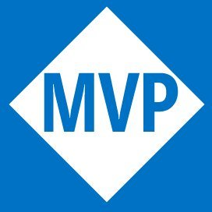





Who am I?
Director of Engineering at Lean TECHniques
Microsoft MVP
Dometrain Author
Redgate Community Ambassador
Co-organizer of Iowa .NET User Group
@scottsauber
@scottsauber.com

Slide 7
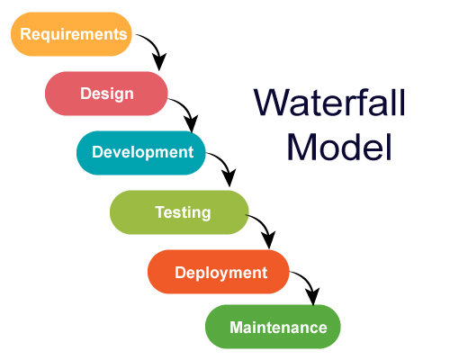
Before agile
Waterfall
Batch everything
Do all work up front before next steps
Problem is software changes
People and companies change their mind, environments change, etc
Changing anything blows up the entire plan
Projects would take years without delivering value
scottsauber

Slide 8
What is agile?
The ability to respond to change quickly and safely
Software is uncertain, let’s make small bets instead of large ones
A set of principles to guide to the ultimate goal of satisfying the customer through early and continuous delivery of valuable software
scottsauber

Slide 9
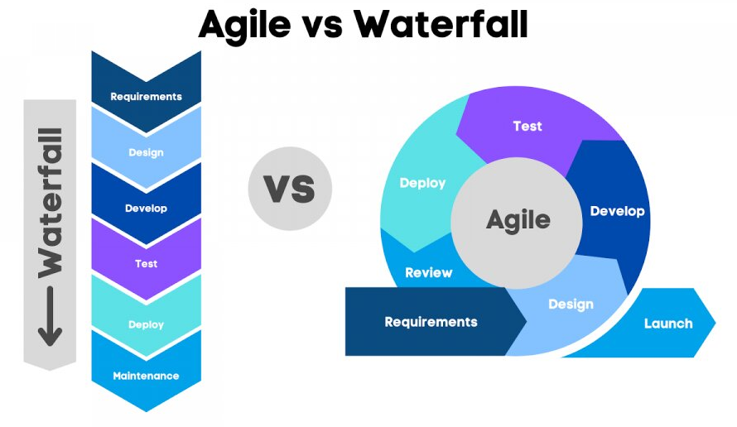
scottsauber

Slide 10
Agile Manifesto
2001 a group of 17 individuals met to talk in Snowbird, Utah
Came up with a set of principles to guide to the ultimate goal of satisfying the customer through early and continuous delivery of valuable software
https://agilemanifesto.org
scottsauber

Slide 11
That’s it.

Slide 12
Or it should’ve been…

Slide 13
Framework Review

Slide 14
Frameworks emerged
Scrum
Kanban
Scrumban
SAFe
scottsauber

Slide 15
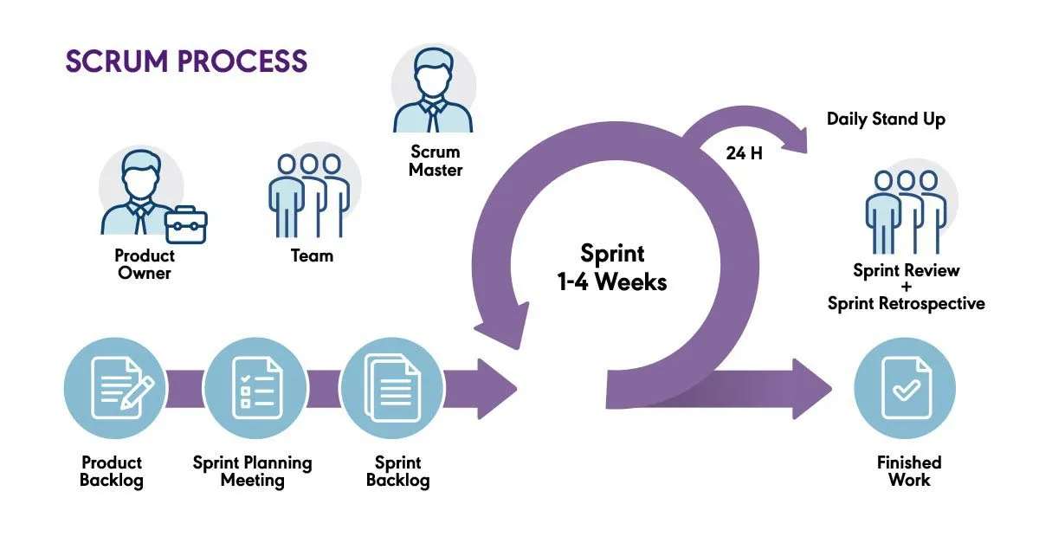
Scrum at a high level
Most popular Agile framework in my experience
Sprint (1-2 week cadences)
Everything falls within the Sprint
Sprint Planning/Sprint Refinement with Story Points
Daily Standups
Sprint Review/Demos
Retrospective
scottsauber

Slide 16
Story Points Refresher
Created by Ron Jeffries
Unit of measure to represent effort and risk
Usually Fibonacci sequenced (1, 2, 3, 5, 8, 13, etc)
Usually estimated during Planning Poker done during Refinement
Can’t be compared across teams reliably (plz don’t try)
Ron Jeffries in 2019: “Well, if I did invent story points, I’m probably a little sorry now… If they’re not providing great value to your team or company, I’d advise dropping them on the grounds that they are waste. If, on the other hand, you just love them, well, carry on!”
scottsauber

Slide 17
Kanban at a high level
No Sprints
Visualize work
Organize work by priority
Pull the next most important thing off the backlog
Optimize flow and limit WIP
scottsauber

Slide 18
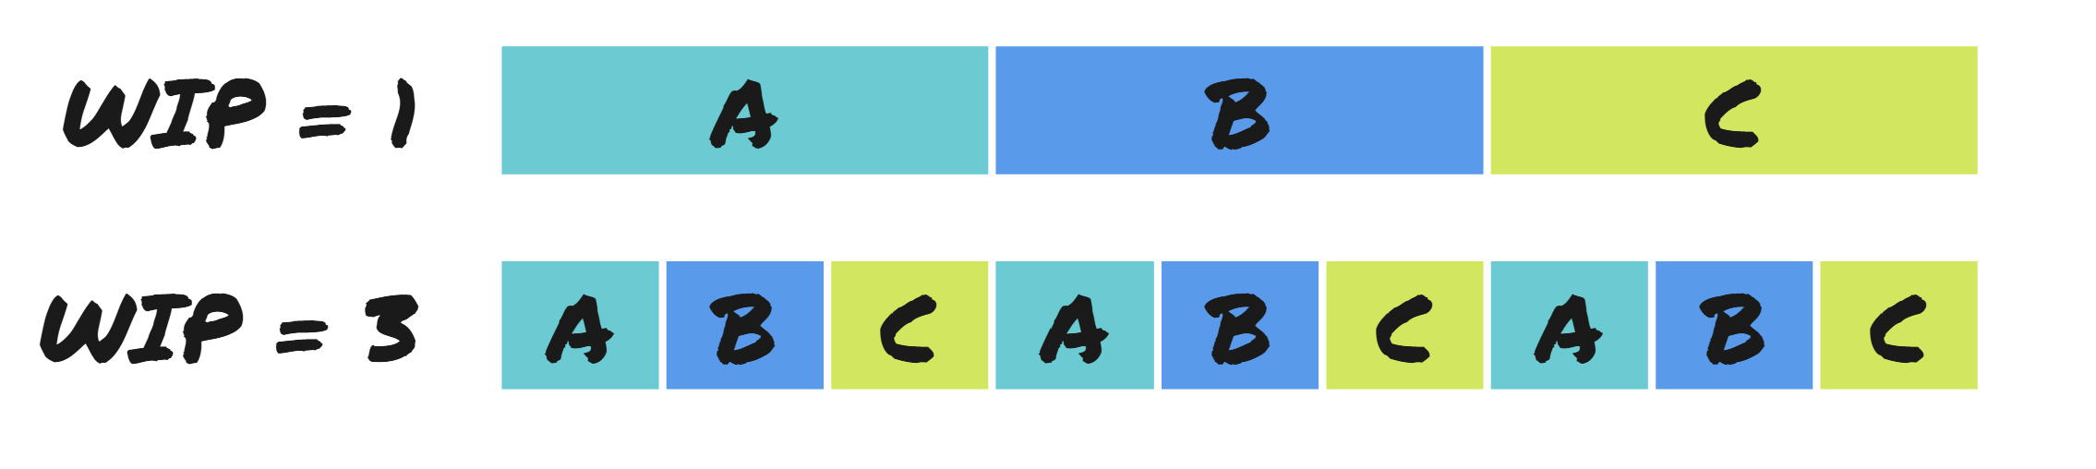
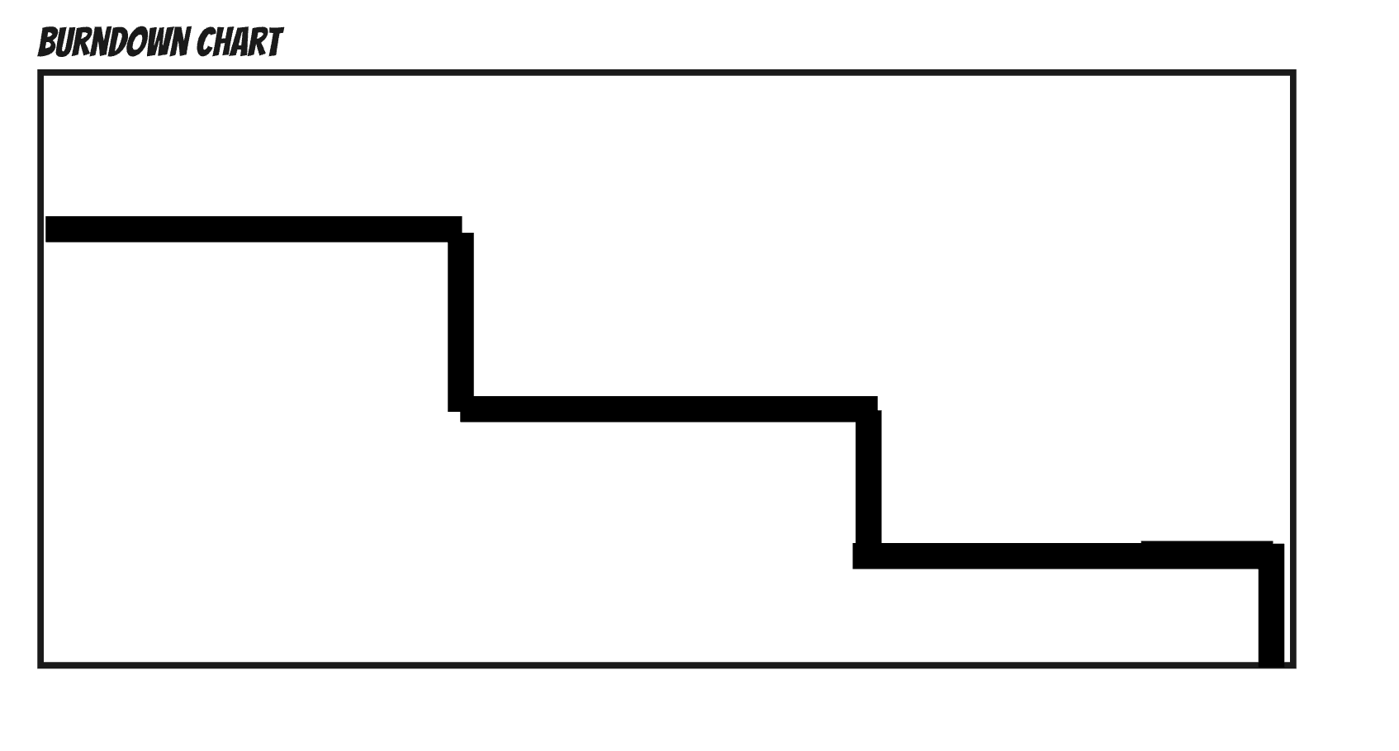
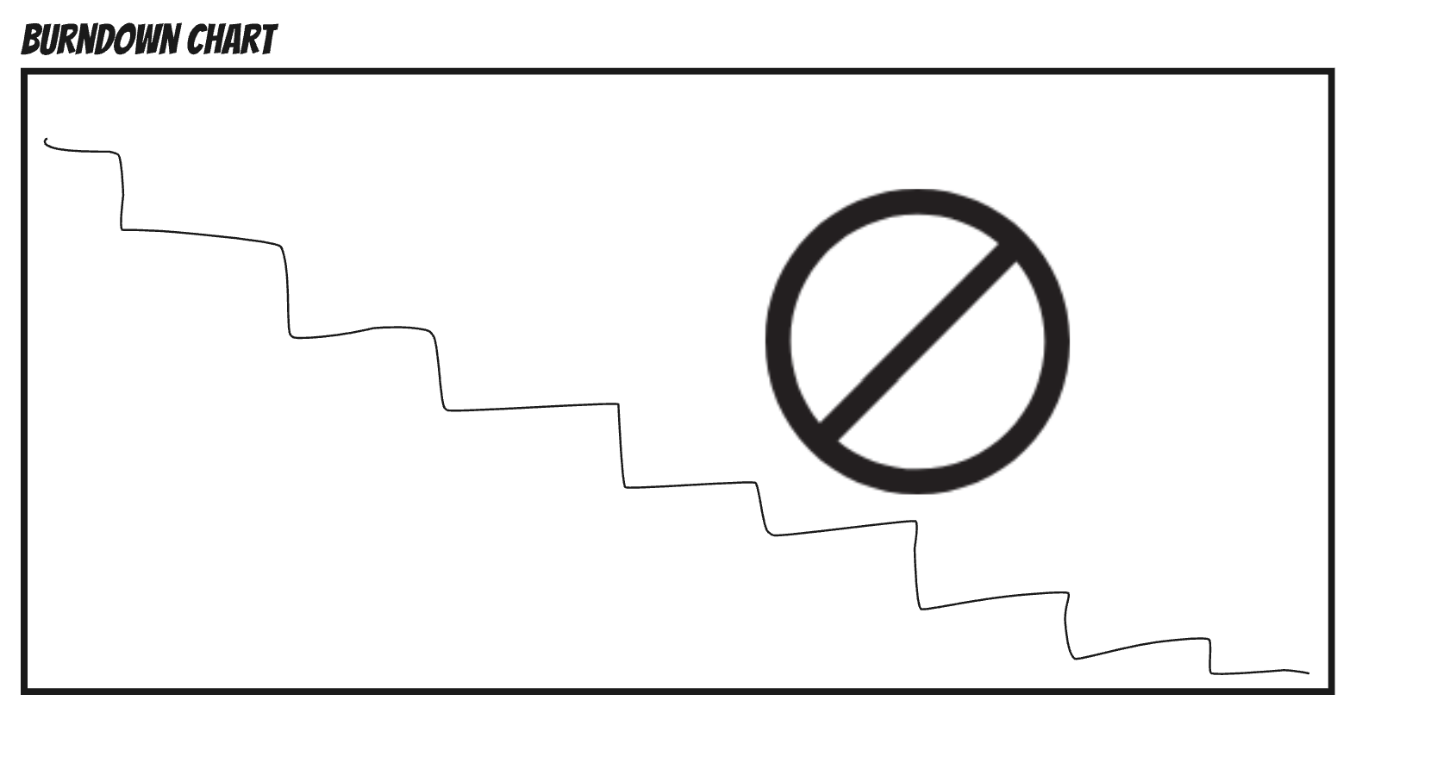
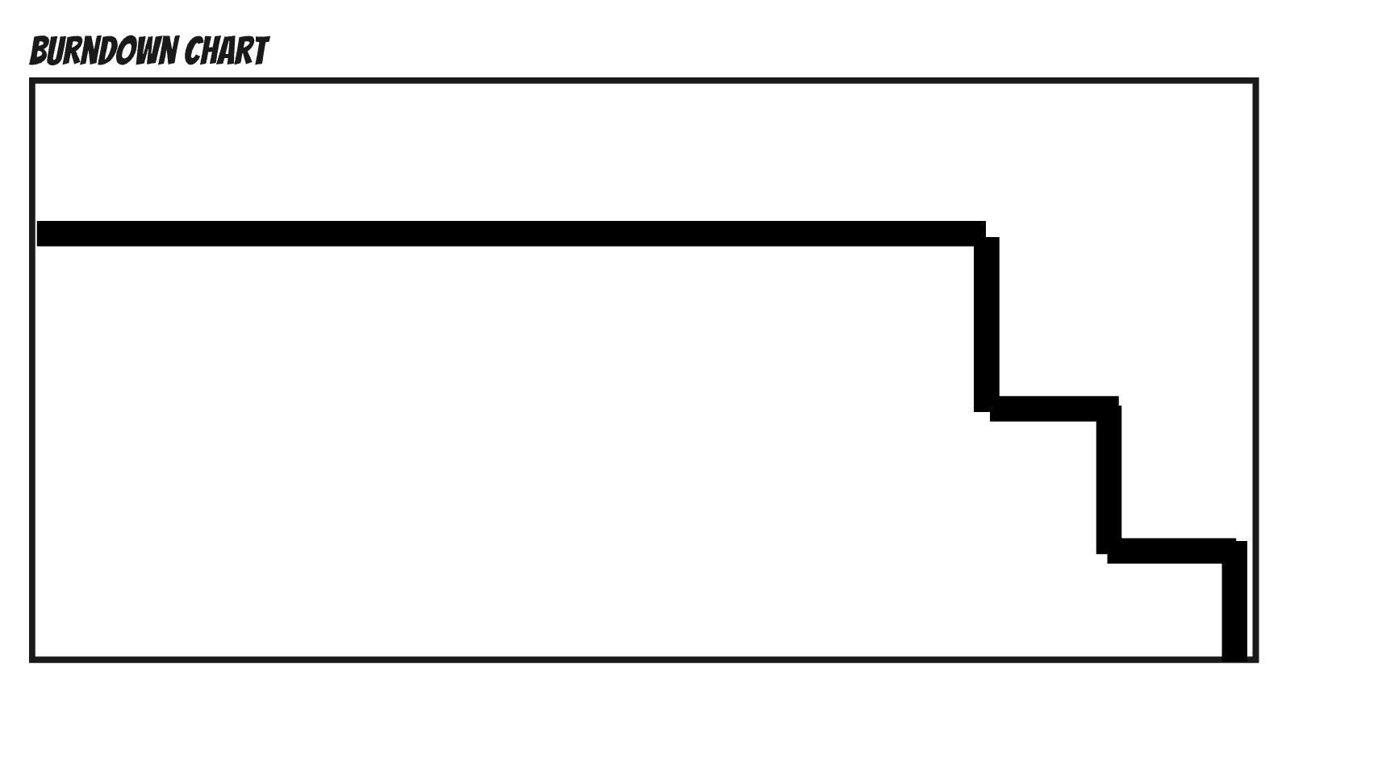
scottsauber

Slide 19
Scrumban at a high level
Use Scrum for planning/alignment, Kanban for execution/flow
Planning/Refinement
Daily Standups
Sprint Review/Demos
Retrospective
Sprint goes away
scottsauber

Slide 20
Frameworks
Meant to encourage agility
Go through the motions of the same old process
Forget to think about why
Frameworks are useful as a starting point if you don’t know what else to do
scottsauber

Slide 21
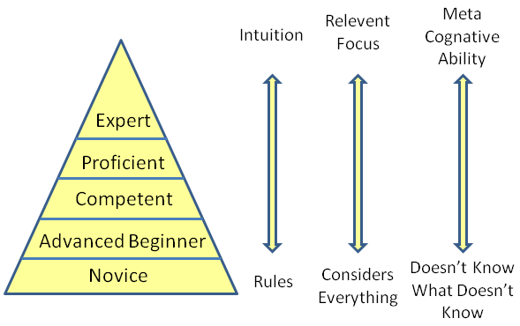
Dreyfus Model
scottsauber

Slide 22
That’s Agile, what about agile?

Slide 23
What is agile?
The ability to respond to change quickly and safely
A set of principles to guide to the ultimate goal of satisfying the customer through early and continuous delivery of valuable software
https://agilemanifesto.org
scottsauber

Slide 24
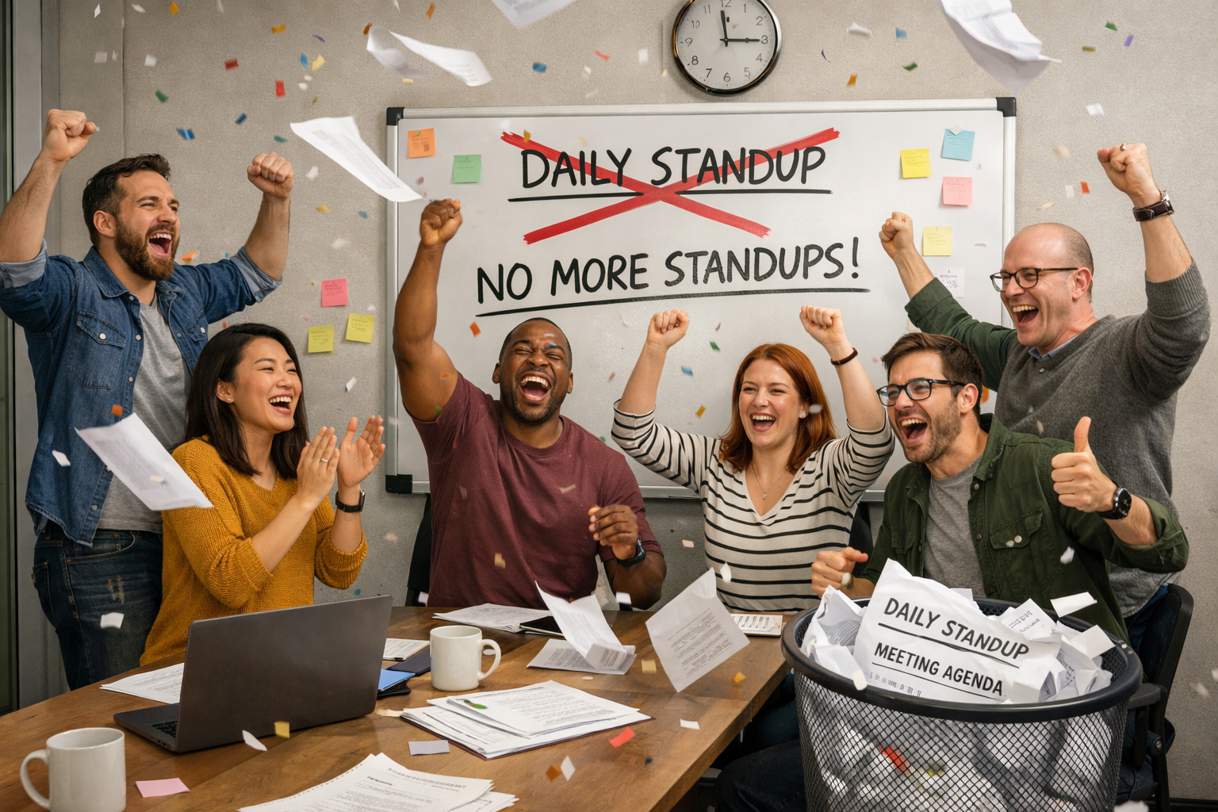
Story time
scottsauber

Slide 25
What Agile traps do organizations fall into?

Slide 26
Problem with Sprints

Slide 27
Problems with Sprints
Sprints are a good first step if you’re doing waterfall
The best teams graduate out of sprints, in my experience
scottsauber

Slide 28
Problems with Sprints
Commit to work 1-2 weeks ahead of time
Inevitably, new work comes up messing up your plans
Not completing committed work drags the team down
18 points in refinement but 20 points of capacity… what happens?
Working on a 5 point story and it rolls into next sprint… what happens?
“I can’t address that issue right now, I need to merge this PR because the sprint ends soon. I’ll get to it later.”
“We’re done 1 day early with the sprint… I don’t want to pull in anything new”
scottsauber

Slide 29
Stop doing Sprints
Sprints are an arbitrary and make you do “weird” things
Instead, organize work in priority order
Do Refinement, Retros, etc every 1-2 weeks
Lots of conversations “vanish”
scottsauber

Slide 30
Problems with SAFe

Slide 31
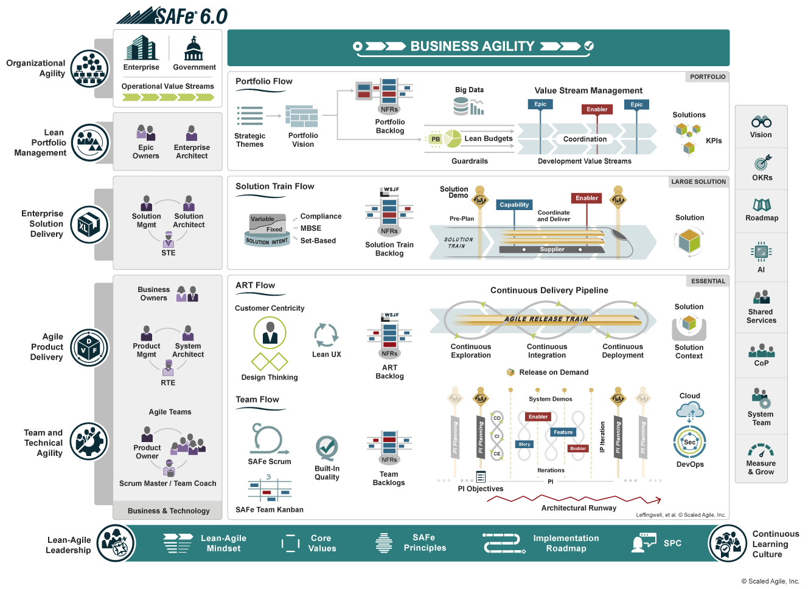
scottsauber

Slide 32
Stop doing SAFe
SAFe optimizes for certainty
Antithesis of agile which optimizes for change
SAFe does not optimize for change, autonomy, removing dependencies (manages them instead), etc.
SAFe can be effective as a transitional framework, not a destination
Chet Hendrickson: “(SAFe) optimizes for risk averse people, I’m not optimizing for security and safety, I’m optimizing to be able to react quickly to change. SAFe can work well for alignment, if you’re going the right place, but if the world is changing…”
scottsauber

Slide 33
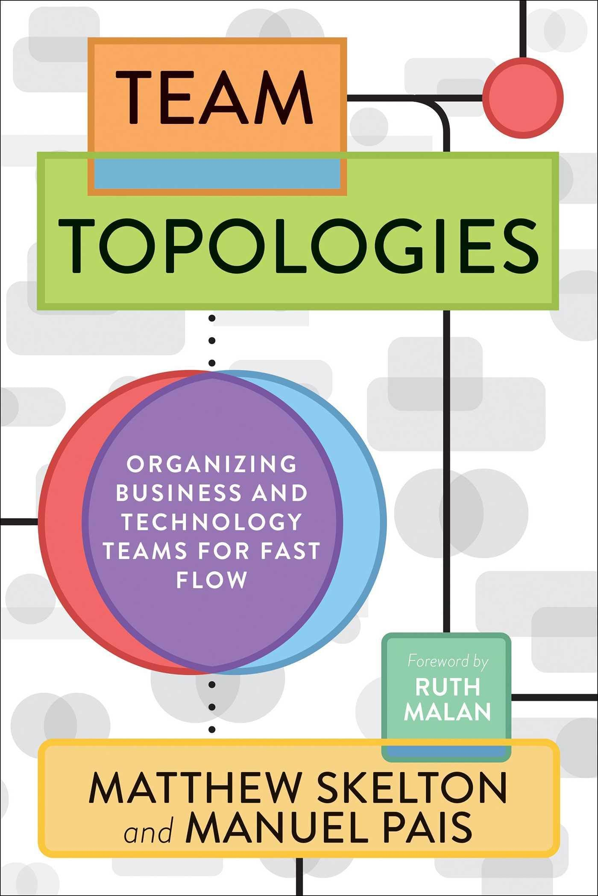
Instead…
Conway’s law says our software mirrors our org structure
Management are the real architects
Change the org structure
Align teams to value streams and remove dependencies
Scales via architecture and boundaries, not meetings
Reduces coordination load, not manage it harder
BTW - you shouldn’t have frontend and backend teams
Team Topologies book for more
scottsauber

Slide 34
Problems with Story Points

Slide 35
Problems with Story Points
Meant to remove time from equation – in practice… “1 point is like 1 day, right?”
Velocity becomes performance metric – bloat story point estimating
Management uses it to compare teams – DON’T DO THIS
Estimation meetings become expensive – way less valuable if team has durability.
“How many points we delivered” isn’t relevant – “How much value we delivered” is what really matters
scottsauber

Slide 36
Do “No Estimates” instead
Break down work into relatively the same size
Stories should still add value when completed – don’t break down too much
Still can understand velocity and prediction – ie 20 stories completed a week
At a minimum, if using story points, never have something bigger than a 5 – break it down
Downside – if it’s a new team, sometimes Planning Poker Discussions can be valuable, but Pairing overcomes this
“Is the value of estimating higher than the cost of estimating?”
scottsauber

Slide 37
Random tips
If you’re a shared services team that intakes support tickets – don’t do Scrum, do Kanban
If you’re a new team, start with weekly ceremonies, not bi-weekly.
Graduate to bi-weekly as you start Norming and Performing
scottsauber

Slide 38
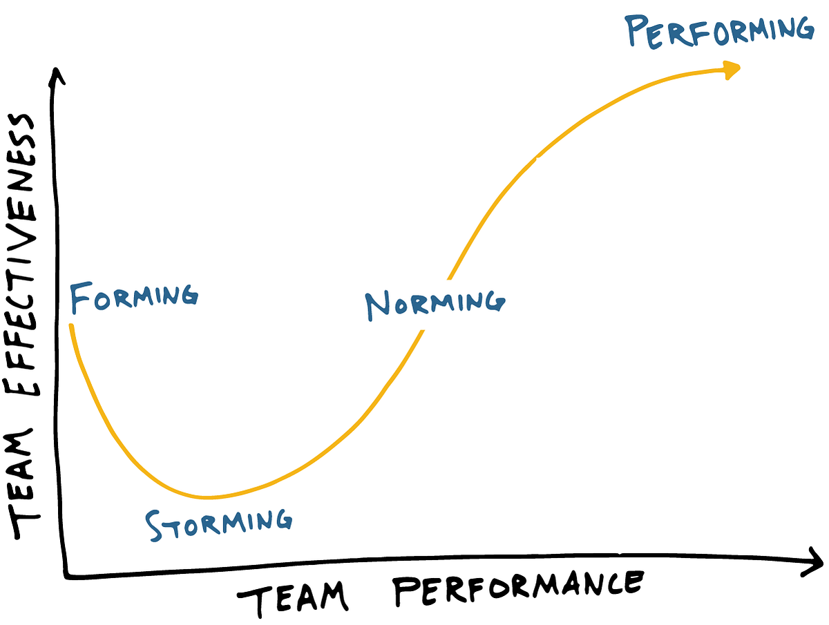
scottsauber

Slide 39
How do I know if I’m doing agile right?

Slide 40
What was the point of agile again?
The ability to respond to change quickly and safely
A set of principles to guide to the ultimate goal of satisfying the customer through early and continuous delivery of valuable software
scottsauber

Slide 41
Build It Right with DORA
DevOps Research Assessment interviews 10s of 1000s of teams
Found it came down to 4 metrics and 34 capabilities
https://dora.dev
Also: SPACE and tools like DX, but start with DORA
DORA’s metrics prove that you can respond to change quickly and safely
The Quick Check compares you against your peers
scottsauber

Slide 42
Build The Right Thing
But it doesn’t matter if we can respond to change, if we’re responding to the wrong change
Too often we measure Efficiency and not Effectiveness
Define success criteria for a story, retro back on it
Define North Star metrics and track them
Usage is always a good metric
Jeff Patton video on Output vs Outcome vs Impact
My number 1 beef with Scrum is there’s no ceremony that emphasizes “did what we build actually matter”
scottsauber

Slide 43
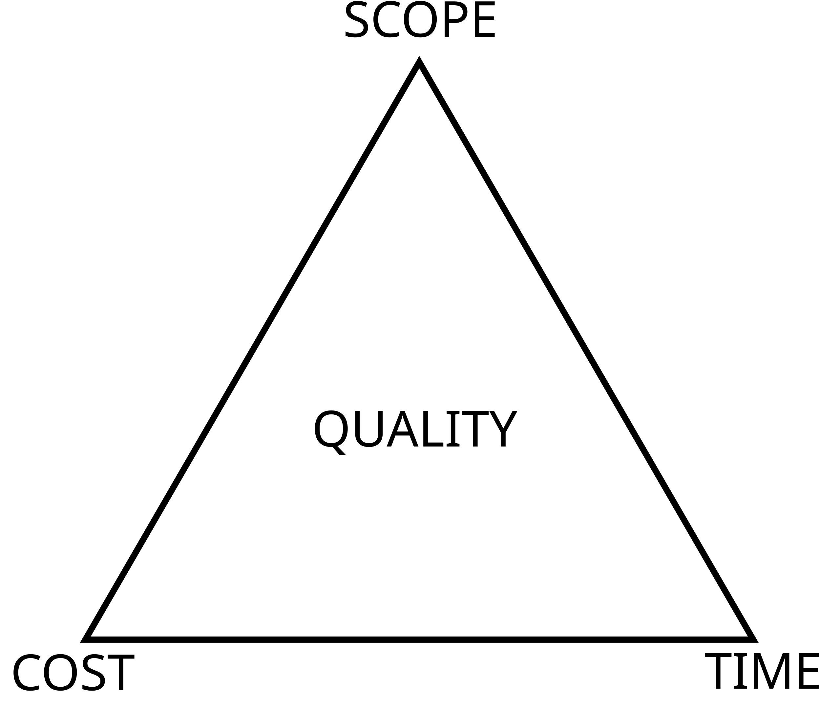
The Iron Triangle
scottsauber

Slide 44
What’s the problem?
scottsauber

Slide 45
It doesn’t measure Outcomes and Impact
scottsauber

Slide 46

scottsauber

Slide 47
Takeaways
Refresher on what agile is supposed to be about
Ideas on how to improve your agile processes
scottsauber

Slide 48
Resources
This slide deck at https://scottsauber.com
scottsauber

Slide 49

Questions? ssauber@leantechniques.com
Add me on LinkedIn:
Slides at scottsauber.com
@scottsauber
@scottsauber.com

Slide 50
Thanks!
Add me on LinkedIn:
Slides at scottsauber.com

